Slide 1
Strategic Project Management
Measures, Metrics, and Indicators
Dr. Richard Scudder Copyright 2018
1

Slide 2
Agenda
OPM3 Project Maturity Model
Metrics and Measurement Techniques
  Financial metrics
  Standard project metrics
  Qualitative metrics
  Earned Value Analysis
Creating a Performance Measurement System (PMS)
Software Tools
Case Study: PMS System and Maturity Measurement
Dr. Richard Scudder Copyright 2018
2

Slide 3
Strategic PM Roadmap
Effective Management
Processes
Portfolios
Programs
Projects
Defined Methods
Measure Results
Pilots
Baselines
Inputs
Management
Clients
Customers
Employees
Stakeholders
Measurement
Risks
KPIs
Metrics
Measurements
Estimates
Consensus
Dr. Richard Scudder Copyright 2018
3
Slide 3

Slide 4

Metrics
The problem:
90/90 Rule
The first 90% of the project takes the first 90% of the time, and the last 10% of the project takes the other 90% of the time!
From Don Gause and Gerry Weinberg
How does a project get to be a year late? ... One day at a time.
Frederick Brooks, Jr., The Mythical Man Month
Dr. Richard Scudder Copyright 2018
4
Notes:
4
Humor and reality

Slide 5
Metrics
We all think we’re on schedule and within budget - the daily numbers prove it - but 66% of all projects don’t meet the original goals.
Why?
Dr. Richard Scudder Copyright 2018
5
Notes:
5
More on “but I already track”

Slide 6
Metrics
There are lies, damn lies, and statistics.
  Mark Twain
Liars can figure, and figures can lie.
  Anonymous
We need to pick the numbers which really let us know how this project is doing.
Dr. Richard Scudder Copyright 2018
6
Notes:
6
Numbers games

Slide 7
Metrics
Generally, metrics are designed to reflect progress in the areas of resource utilization (i.e., budget, people, and assets), schedule, technical achievements, performance milestones, and others. Project metrics will vary depending on the project nature.
  PMI Seminar: How to Choose Appropriate Metrics to Achieve the Required Outcomes
Dr. Richard Scudder Copyright 2018
7
Notes:
7
Numbers games

Slide 8

Metrics
Good metrics give us a look at our project right now as well as into the future.
They are similar to the “leading indicators” used by economists, which give the economists an idea where the economy might be going.
Metrics should be an early warning system, which gives us the ability to take corrective action in time to put a project back on track.
Dr. Richard Scudder Copyright 2018
8
Notes:
8
From the Battelle, Rosen medical device (MDDI) article

Slide 9

Metrics and Measurement Techniques
How do we know which metrics to use?
  The metrics must let the project team, project manager, and higher level managers know that the project-critical and organization-critical needs are being met, or that they aren’t.
    AND
  The metrics used must allow managers to effectively (re) allocate resources and priorities within and between projects, as needed.
Dr. Richard Scudder Copyright 2018
9
Notes:
9
Battelle Rosen

Slide 10
Metrics and Measurement Techniques - Example
The product of a particular project needs to be available by a market deadline.
  Meeting project milestones will be critical to having the product by the deadline.
  The milestones will only be valid if they are based upon good work breakdowns, with the tasks being realistically estimated and scheduled.
  So the measures include time and tasks.
  The metrics we need to track to meet the milestones include task hours against estimates, as well as task completion against the project schedule.
There are many assumptions here:
  resource time and task completion are being tracked (accurately):
  estimates were made from the work breakdown;
  the work breakdown accurately reflects what needs to be done to complete the project, and so on.
Dr. Richard Scudder Copyright 2018
10
Notes:
10
Battelle Rosen example, expanded BUT see the next slide

Slide 11
Use of Metrics
Metrics usually measure resource utilization
  People
    Hours
    Number of people assigned
  Budget
  Schedule
  Milestones reached
Dr. Richard Scudder Copyright 2018
11
Notes:
11
Stating the obvious

Slide 12

Use of Metrics
Metrics are unique to:
  The project
  The organization
Your metrics will evolve as your organization finds what is useful through tracking projects, including what worked and what didn’t, estimates vs. actuals, and how your people responded to the project plans and corrective feedback.
Dr. Richard Scudder Copyright 2018
12
Notes:
12
And giving a sense of direction

Slide 13
Aspects of Metrics:
Measurement
Measurements
  Measurement for measurement's sake is a waste of time and money. Measurements need to be expressed in everyday terms that are familiar to the organization; otherwise, they may be of little value.
    Article by Scott E. Donaldson and Stanley G. Siegel
Dr. Richard Scudder Copyright 2018
13
Notes:
13
Why measure if no one will really know what the measurement means?? Make the information usable to the people in the organization.

Slide 14
Aspects of Metrics:
Measurement
Measurement
  The key reasons for measuring a product or service are to:
    Characterize development processes and products
    Evaluate project status with respect to plans
    Predict, so that projects can be planned
    Guide improvements of the development/engineering processes
      Jeff Nyman, Global tester
Dr. Richard Scudder Copyright 2018
14
Notes:
14
The world is an increasingly competitive place. Products are evaluated quickly and ruthlessly, as are the organizations that produce them.
Thus, product and process improvement becomes critical.

Slide 15

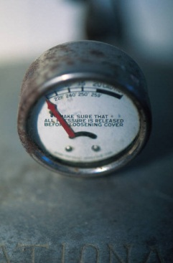
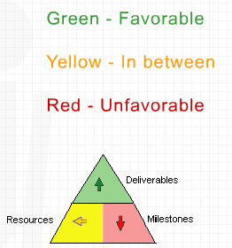
Levels of Metrics
Measures
Metrics
(Key Performance) Indicators (KPIs)
Dr. Richard Scudder Copyright 2018
15
Notes:
15
There are different levels of measuring.
At the most basic level, we measure.
At the next level, we set up more sophisticated measurements, such as defects/1000 units produced in software and manufacturing or $ of revenue/employee.
At a higher level yet, we look for indicators to measure whether we are profitable and how our profitability is increasing or decreasing over time (trends).

Slide 16
Levels of Metrics:
Measures
Measure
  A measure provides a quantitative indication of the extent, amount, dimensions, capacity, or size of some attribute of a product or process.
  Measures are quite often determined by a standard or a set of standards. Examples of measures include a count of the number of defects or a count of source lines of code (SLOC). Another good example is earned value. This is a measure of the value of work performed. Earned value uses original estimates and progress-to-date to show whether the actual costs incurred are within some particular budget.
  Measurements can be classified in several ways: objective/subjective, absolute/relative, explicit/derived, dynamic/static, and predictive/explanatory.
    Jeff Nyman
Dr. Richard Scudder Copyright 2018
16
Notes:
16
Basic measurement is the foundation of all PM improvement efforts. Attempting improvement without measurement is blind.
BASE UNITS
Measurements can also qualitative or quantitative.

Slide 17
Examples of
Standard Project Measures
Cost (staff effort, phase effort, total effort)
Process characteristics (process model, technology)
Project dynamics (changes or growth in requirements)
Project characteristics (development dates, project size, total effort)
Product structure (size, complexity)
Dr. Richard Scudder Copyright 2018
17
Notes:
17
Some PM basics

Slide 18
Levels of Metrics –
Metrics Definition and Types
Metric
  A metric is a quantitative measure of the degree to which a system, component, or process possesses a given attribute.
  Metrics are derived from measures.
  Metrics may indicate process or product qualities that are not directly measurable and, if not addressed by metrics, are subjective and intangible. For instance, a software metric can define a standard way of measuring some attribute of the software development process, such as size, cost, defects, communications, difficulty, or environment.
Dr. Richard Scudder Copyright 2018
18
Notes:
18
INFORMATION
Metrics are derived from basic measurements:
1) Measurement: how many widgets did we produce?
2) Measurement: how long did it take to produce those widgets?
3) Measurement: how many employees worked to produce the widgets?
4) Metric: how many widgets did we produce per unit of time, or per employee?
5) Measurement: using similar (basic) data, how many defects did our widgets have?
6) Metric: how many defects did we have per 1000 widgets?
7) Metric: how many defects do we have per unit of time?
8) Indicator: are the number of defects increasing, decreasing, or staying the same over time (what is the defect trend)?

Slide 19
Examples of
Standard Project Metrics
Effort (man-hours per task, per deliverable, and per phase)
Budget (cost per task, per deliverable, etc.)
Errors (defects per task, per phase, etc.)
% of tasks completed within estimated time
% of tasks completed within estimated cost
Financial (NPV, ROI, ROS, etc.)
Note that these are all derived from original basic measurements regarding the project (or program or at a high level, the portfolio)
Dr. Richard Scudder Copyright 2018
19
Notes:
19
More examples, derived from our original basic measurements
Project Management
Project Time
Project Cost
Project accuracy (specifications met)
Change requests
Quality
Safety (if applicable)
Project Success
Benefit(s) to the organization
Stakeholder satisfaction
Users satisfaction
Number of issues recorded since implementation
Ease of use/quantity of use
Happiness/willingness of end users
Solved problem(s) project was intended to solve
Un-intentional improvement/complication to processes/procedures
Business Success
Cost savings/cost reductions
ROI (Return on Investment)
Return on expectations
Competitive advantage
Improved operating efficiencies
Opportunities in the future
Expanding or improving core competency
Enhance productivity
Reducing paperwork
Reducing manual processes
Real time processing/real time reports
Increased accuracy / quality improvements
Customer service improvements
Resource management improvements
Support business growth
Building external linkages
Increased flexibility
Empowerment

Slide 20
Qualitative Metrics
Quality - how good is this product, service, or process?
  Perhaps is could be objectively measured on a scale of 1-5, but it could also simply be “good” (for our purposes) or “bad”
  Qualitative metrics are useful when there is no obvious measure or metric to define “good” or “useful”
  Even though these metrics have no “objective” measurement scale, they can still be rank-ordered. Out of these five items, this is #1, this is #2, and so on
Dr. Richard Scudder Copyright 2018
20
Notes:
20
If there is no way to measure usability or goodness, we can still evaluate the product or service using such qualities as goodness or usefulness
Rank ordering a set of items puts them in order by forcing a comparison between the first item (service, etc.) and the one immediately after it. This process continues until the first item has been compared to all the other items. The top ranked item is now #1. Then the second item is compared to the remaining items, and the top ranked item out of that set becomes #2. The process is continued until all items have been compared to each other one at a time.

Slide 21
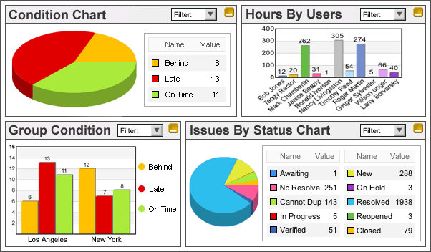
Levels of Metrics - Indicators
Indicator
  An indicator is a metric or combination of metrics that provide insight into a process, a project, or the product itself.
  Trends, comparisons, insights
  Allows analysis of products, services, processes
This Photo by Unknown Author is licensed under CC BY-SA
Dr. Richard Scudder Copyright 2018
21
Notes:
21
Now we are potentially at a level where we can see trends, examine how well a process is working, or determine how to improve a product.

Slide 22
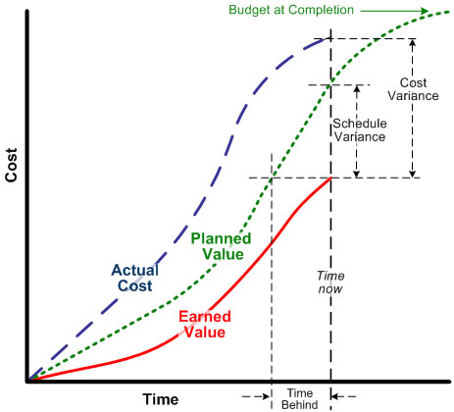
Earned Value Analysis -
A Key Set of Indicators
Key Metric/Indicator Method
Based on well estimated schedule
Tracks both Time and Cost
Analyzes current progress and projects future progress
Gives visibility to program performance
Increases accountability
Helps reduce risk
Dr. Richard Scudder Copyright 2018
22

Slide 23
Project Gantt Chart
DAY TASK # | 1 | 2 | 3 | 4 | 5 | 6 | 7 | 8 | 9 | 10 | 11 | 12 | 13 | 14 | 15 | 16 | 17 | 18
1
2
3
4
5
6
7
8
Cost: $10,000 per day

Slide 24
Daily Cost Spend
DAY | Task | Daily Cost | Cumulative Cost
1 | 1+2 | $20,000 | $20.000
2 | 1+2 | $20,000 | $40,000
3 | 1+3+4 | $30,000 | $70,000
4 | 1+3+4 | $30,000 | $100,000
5 | 1+5 | $20,000 | $120,000
6 | 1+5 | $20,000 | $140,000
7 | 5+6 | $20,000 | $160,000
8 | 5+6 | $20,000 | $180,000
9 | 5+6 | $20,000 | $200,000
10 | 7 | $10,000 | $210,000
11 | 7 | $10,000 | $220,000
12 | 7 | $10,000 | $230,000
13 | 7 | $10,000 | $240,000
14 | 7 | $10,000 | $250,000
15 | 7 | $10,000 | $260,000
16 | 8 | $10,000 | $270,000
17 | 8 | $10,000 | $280,000
18 | 8 | $10,000 | $290,000

Slide 25
COST CURVE
Cumulative Cost Curve: Total Cost = BAC = $290k
$290k
$200k
$100k
$50k
1 2 3 4 5 6 7 8 9 10 11 12 13 14 15 16 17 18
Dr. Richard Scudder Copyright 2018
200k
290k
25
Notes:
FTG= ESTIMATE TO GO
EAC= ESTIMATE AT COMPLETION
BAC= BUDGET AT COMPLETION
FCST= FORECAST OF REMAINING WORK
ACWP= ACTUAL COST OF WORK PERFORMED
BCWP= BUDGETED COST OF WORK PERFORMED
BCWS = BUDGETED COST OF WORK SCHEDULED
25

Slide 26
Spending Curve
Total cost or BAC is $290k
Why isn’t the cost $145k when half the project is finished instead of $290k?
What is the relationship between the curve and earned value?
The relationship between cost
and schedule is not linear!
Dr. Richard Scudder Copyright 2018
26

Slide 27
Tools for Understanding Cost and Schedule
PV (Planned Value) Planned costs for the work to be done at a point in time (for day 9 this is $200k)
EV (Earned Value) Percentage of the planned work that was accomplished
AC (Actual Cost) Amount spent on the work that was accomplished
BAC (Budget At Completion) Total Planned Cost ($290k)
Dr. Richard Scudder Copyright 2018
27

Slide 28
Earned Value Calculations
Schedule Variance (SV) = EV – PV
Schedule Performance Index (SPI) = EV/PV
Cost Variance (CV) = EV – AC
Cost Performance Index (CPI) = EV/AC
Estimate at Completion = BAC/CPI
Dr. Richard Scudder Copyright 2018
28

Slide 29
Earned Value
All the formulas build off of EV one way or the other
We want to look at the percent of work that was completed against what we planned to do
We also want to see how far off schedule and cost the project might be
EV is the basis for both of these
Dr. Richard Scudder Copyright 2018
29

Slide 30
Calculating EV
If at Day 9 we have planned value of 200k, and everything is complete, the project is OK.
If on the other hand, we look at the figures and find that we have only accomplished 80% of our tasks, what does that tell us?
Our EV was supposed to be $200k – it is only $160k
In addition, Accounting tells us that we have actually spent $175k
The project is in trouble….
Dr. Richard Scudder Copyright 2018
30

Slide 31
Calculating EV
PV = $200k
EV = $160k
AC = $175k
CV = - $15k
CPI (EV/AC) = 91%
SV (EV-PV) = -$40k
SPI (EV/PV) = 80%
EAC (BAC/CPI) = $318k
We will be
overbudget at
current spend
Dr. Richard Scudder Copyright 2018
31

Slide 32
AS-IF
DAY | Task | Daily Cost | Cumulative Cost | SPEND
1 | 1+2 | $20,000 | $20.000 | $20.000
2 | 1+2 | $20,000 | $40,000 | $40,000
3 | 1+3+4 | $30,000 | $70,000 | $70,000
4 | 1+3+4 | $30,000 | $100,000 | $120,000
5 | 1+5 | $20,000 | $120,000 | $130,000
6 | 1+5 | $20,000 | $140,000 | $150,000
7 | 5+6 | $20,000 | $160,000 | $175,000
8 | 5+6 | $20,000 | - | $195,000
9 | 6 | $8,000 | - | $203,000
10 | 5+6 | $20,000 | $180,000 | $223,000
11 | 5+6 | $20,000 | $200,000 | +
12 | 7 | $10,000 | $210,000 | +
13 | 7 | $10,000 | $220,000 | +
14 | 7 | $10,000 | $230,000 | +
15 | 7 | $10,000 | $240,000 | +
16 | 7 | $10,000 | $250,000 | +
17 | 7 | $10,000 | $260,000 | +
18 | 8 | $10,000 | $270,000 | +
19 | 8 | $10,000 | $280,000 | +
20 | 8 | $10,000 | $290,000 | $318,000

Slide 33
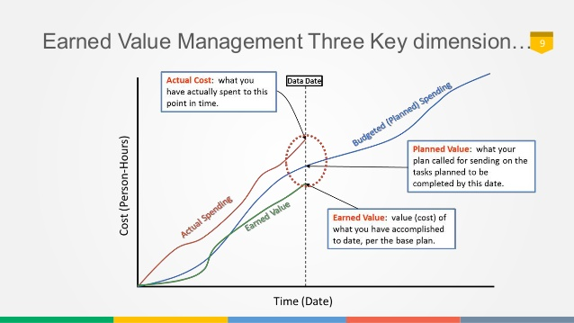

Slide 34
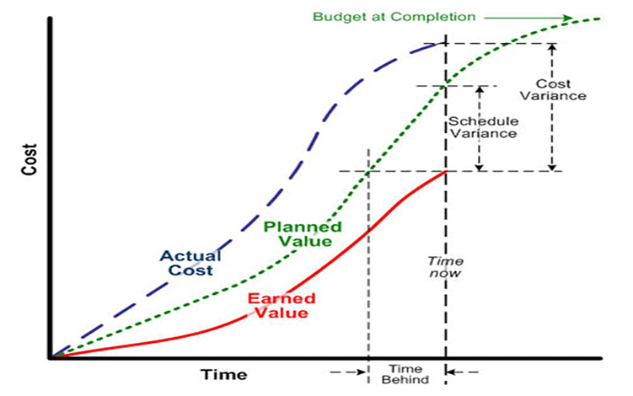

Notes:
34

Slide 35
Creating a Performance
Measurement System (PMS)
Dr. Richard Scudder Copyright 2018
35

Slide 36
PMS
Earned Value Analysis is one major method of measuring project performance
How else can we measure performance?
  We can use scorecards and dashboards
  Using metrics and indicators discussed earlier in this section, we can construct a PMS system based upon our organization’s specific needs
  In the Improvement section, we will explore in detail some of the specific metrics which can be used in a PMS
Dr. Richard Scudder Copyright 2018
36
Notes:
36

Slide 37
Software Tools –
Metrics and Indicator Toolsets
Tools used to display metrics and indicators include:
  Business Intelligence Software Tools
    Scorecards or
    Dashboards
Dr. Richard Scudder Copyright 2018
37
Notes:
37

Slide 38
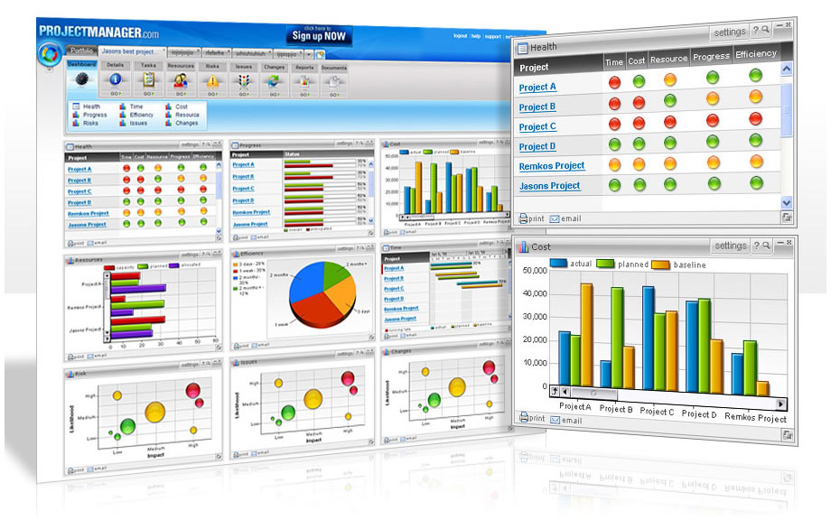
The Purpose of a Scorecard
A scorecard should give a manager a visual representation of the health of an organization in a single glance.
The scorecard needs to be of sufficiently high level to represent major business operations and their goals.
The data in a scorecard should be as recent as possible to make them more useful and actionable.
This Photo by Unknown Author is licensed under CC BY-NC
Dr. Richard Scudder Copyright 2018
38
Notes:
38
When a student is in school, their parents probably don’t have a chance to examine every paper and every assignment which receives a grade. Instead, parents get periodic reports on their child’s progress through a report card. This report card shows a high level summary of all the assignments and tests given during a period of time; it is a single value rolled up from all the individual grades.
Similarly, business executives don’t have time to look at all the details; they need a report card that summarizes the health of the business. This doesn’t mean that they don’t need to know the details at a more granular level if things are bad, but the scorecard’s purpose is to be that quick, high level summary.
Generally scorecards are updated nightly or weekly so that they are as current as possible. This means that any indicators which are trending down or that move into yellow or red categories can be spotted quickly and acted upon.

Slide 39

The Contents of a Scorecard
Scorecards usually contain some or all of the following elements:
  Key Performance Indicators (KPIs)
  KPI actual values compared to historical values (for trend analysis)
  KPI actual values compared to a forecast or budget amount
  Rankings of different departments, locations, products, and so forth
Dr. Richard Scudder Copyright 2018
39
Notes:
39
Scorecards generally report the Key Performance Indicators, or KPIs, of the business. KPIs are often thought of as financial indicators such as sales, expenses, profit margin, and so forth. However, KPIs may come from other areas of the business, such as defect rates, employee turnover, percentage of employees with a certain certification, and so on.
KPIs are almost always compared to “planned” or “budget” numbers so that the health of the indicator can be determined. How close a number is to the plan indicates the strength and is usually used to determine the indicator to show for that KPI.
KPIs are also often compared to historical values so that trends can be generated. How the trend is determined is up to the business, but a “green” indicator that is trending down might cause an executive to investigate that particular value.

Slide 40
The Purpose of a Dashboard
A dashboard is designed to allow decision makers to see a variety of data that affects their divisions or departments.
This data may be in the form of scorecards, charts, tables, and so forth.
The dashboard is generally customized for each user.
A dashboard is more targeted and detailed than a scorecard.
Dr. Richard Scudder Copyright 2018
40
Notes:
40
A dashboard is a central location that can contain more than just BI data. For example, it may include email, news, stock quotes, and more. This way, decision makers can see internal (organizational) data as well as external data from a variety of sources on a single screen. One of the strengths of a dashboard is that it can be customized for each person so they see only the data that pertains to them. (Warning: to narrow a focus may exclude data which is relevant!)
A dashboard is often more targeted to individuals. If the business decision maker is the head of manufacturing, the KPIs shown would focus on manufacturing and not include sales and marketing KPIs.

Slide 41
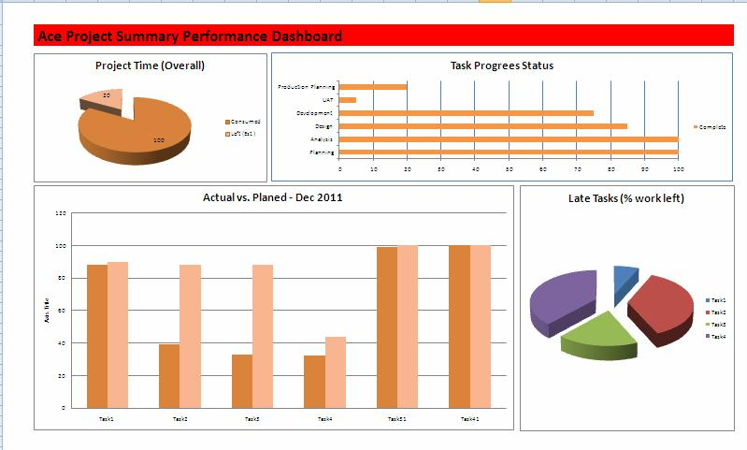
The Contents of a Dashboard
A dashboard generally contains a variety of different views of data.
The data is generally KPIs and shows trends, breakdowns, and comparisons against a forecast or historical data.
The dashboard often consists of charts and tables, and may include scorecard elements as well.
Dr. Richard Scudder Copyright 2018
41
Notes:
41
Dashboards often contain information targeted at a functional area. This means that the dashboard contains KPIs, charts, and grids focused on a functional area. There is often historical information so the executive can get a feel for what has really been happening over time. Dashboards can incorporate non-BI information as well, containing links to a person’s calendar, email, news sources, and more.

Slide 42
Examples of Dashboard
Project Indicators
Example - Software quality indicators
  Defects found per walkthrough (compared to historical average)
  Defects found per project phase (compared to historical average)
  Defects found per KLOC (thousand lines of code) (ditto)
Example - Revenue indicators for telecom expressed as a percentage:
  Billing efficiency: 93
  Guiding efficiency: 92
  Record Polling efficiency: 100
  Pre-process efficiency: 99.5
Actionable information - set alarms and targets so that the indicator results are meaningful:
  Billing efficiency must be 92 or greater (alarm)
    Lower than alarm = red
    Between alarm and target = yellow
    Target or above = green
    Also, which direction is this particular indicator moving? And how fast is it moving in that direction?
  Billing efficiency is desired to be 98.5 (target)
This approach will enable users to prioritize areas of action where they could implement strategies to improve results, so that the overall process can operate as efficiently as possible.
Dr. Richard Scudder Copyright 2018
42
Notes:
42
Not only do we want measures, then metrics, and finally indicators; we also want to know what the indicators mean. Are we improving, deteriorating, have we hit a pre-set level which alerts us to take some action, etc?

Slide 43
Monitoring and
Using Metrics
The Strategic Dashboard
  Gives managers - and project team members – instant access to metrics and indicators.
  Has moved from being a toy to successful pilots to key tool in the past 3 years.
  Based on:
    Clearly defined metrics
    Accurate and complete underlying data
    History
Dr. Richard Scudder Copyright 2018
43
Notes:
43
The idea of the dashboard is similar to the instruments on the dashboard of an automobile. What is our speed, how much fuel do we have left, etc? It gives us a concise overview of the overall operation of the car. A project dashboard can give us comparable information about a project.

Slide 44
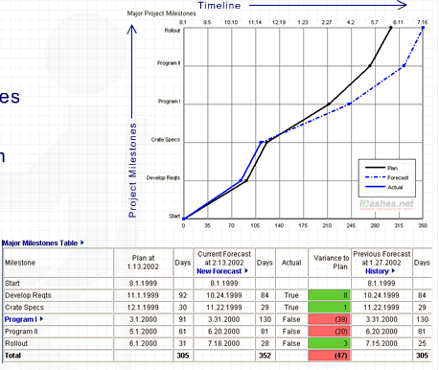
Milestone Indicator
Dr. Richard Scudder Copyright 2018
44
Notes:
44
A PM example, with positive and negative variances highlighted

Slide 45
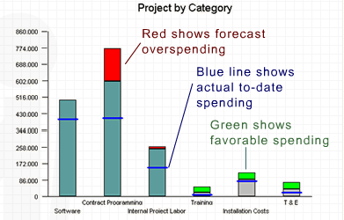
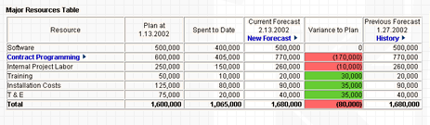
Cost Indicators
Dr. Richard Scudder Copyright 2018
45
Notes:
45
A cost example, again with overruns and under runs highlighted.

Slide 46
Success in using Dashboards and Scorecards
For dashboards and scorecards to deliver strategic benefits:
  they must be aligned with organizational goals;
  they must be based on complete, consolidated and valid data;
  they must focus on the people, processes and systems that can truly impact performance.
Using a strategic approach with the end goal in mind, dashboards can deliver improved performance and competitive advantage.
Dr. Richard Scudder Copyright 2018
46
Notes:
46
Obvious comments

Slide 47
KPIs
Project managers need metrics which allow them to understand key data points throughout the project lifecycle
The project manager, team members, stakeholders and project sponsor all need to get a sense of project progress in a simple straightforward fashion. Overly complex jargon or reports lead to confusion
It is best to identify a few pertinent key performance indicators that will properly convey project status both at a project and portfolio level.
Dr. Richard Scudder Copyright 2018
47

Slide 48
KPIs
KPIs provide a window into the current status but also serve as a means to detect future problems and risks.
The ability to anticipate a risk such as schedule slippage will allow the project team to plan for steps to mitigate the risk.
Different KPIs can yield different insights.
Dr. Richard Scudder Copyright 2018
48

Slide 49
Sample KPIs
Estimate to Project Completion
Number of unresolved issues
Current resource allocation
Labor costs spent per month
Current development backlog
Schedule
Number of QA issues identified
Customer issues identified
Dr. Richard Scudder Copyright 2018
49

Slide 50
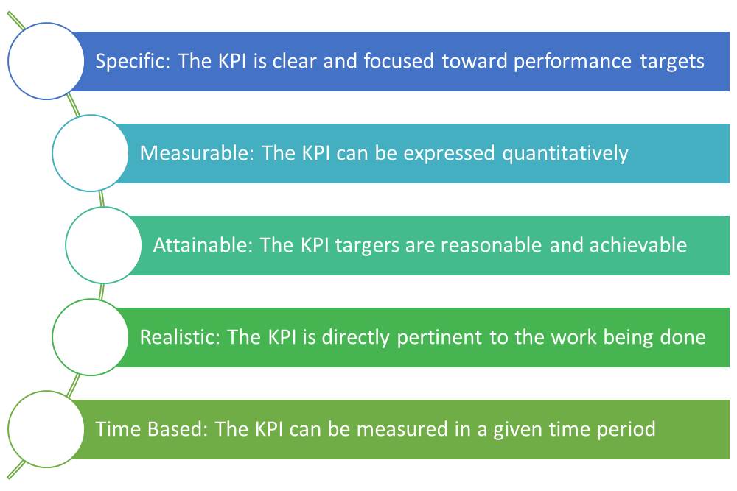





KPI Selection
Dr. Richard Scudder Copyright 2018
50

Slide 51
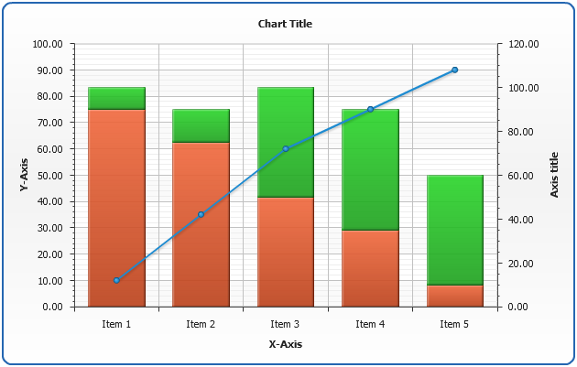
Displays: Standard and stacked histograms
Usage
  Convey total amounts in singular or segmented (stacked) fashiuon
  Provide visual comparisons against totals
Tips
  Avoid too many data points – makes chart hard to read
  Use effective colors
This Photo by Unknown Author is licensed under CC BY-SA
Dr. Richard Scudder Copyright 2018
51

Slide 52
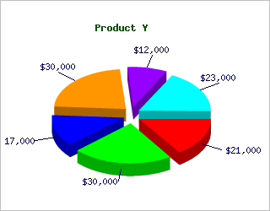
Displays: Pie Charts
This Photo by Unknown Author is licensed under CC BY-SA
Usage
  Conveys percentage amounts in separate pieces
  Provide quick view of larger and smaller segments
Tips
  Keep pieces separated by spaces for easy viewing
  Colors
Dr. Richard Scudder Copyright 2018
52

Slide 53
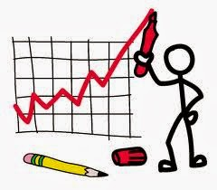
Displays: Line Charts
Usage
  Conveys aggregated data sets in time format
  Provides trending analysis of data points
Tips
  Avoid excessive use of additional line segments – no more than 4 segments per chart
  Color
Dr. Richard Scudder Copyright 2018
53

Slide 54
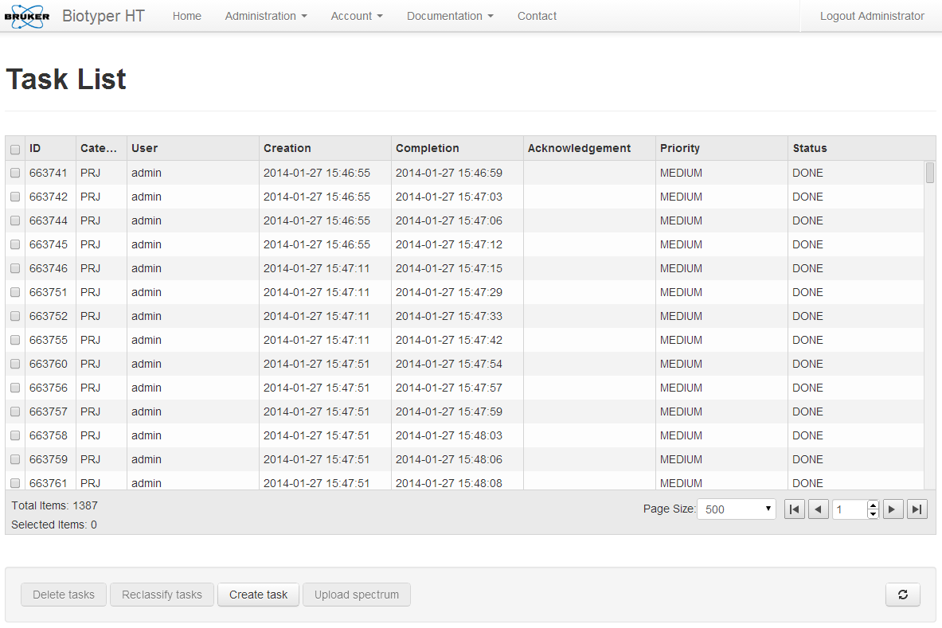
Displays:
Tabular Data
Usage
  Convey key value pieces of data
  Provides “hard” values for analysis
Tips
  Avoid too many lines and columns of data: miminize scrolling
  Use effective fonts consistently
This Photo by Unknown Author is licensed under CC BY-SA
Dr. Richard Scudder Copyright 2018
54

Slide 55
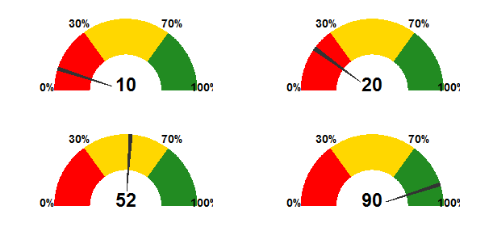
Display Types: Speedometer
Usage
  Conveys progress to completion or current status
  Easy to interpret
Tips
  Keep it simple
  Color
Dr. Richard Scudder Copyright 2018
55

Slide 56
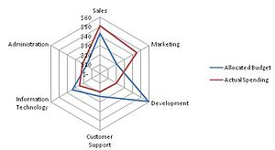
Radar Plot
Usage
  Provides overlay and scatter analysis of data
  Gives indicator of how disparate data points correlate
Tips
  Avoid attempting too may series in one plot
  Color
Dr. Richard Scudder Copyright 2018
56

Slide 57
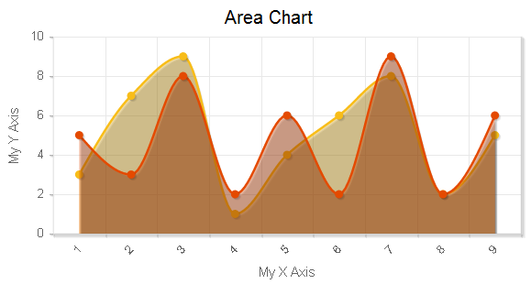
Displays:
Area Graphs
Usage
  Provides line base histogram overlay of multiple series
  Useful for trends and projections
Tips
  Avoid too many series
  color
Dr. Richard Scudder Copyright 2018
57

Slide 58
Dashboards
Avoid too many items on a singular dashboard
Use effective spacing
Keep tiles to uniform sizes when possible – easier to scan equally sized tiles
Leverage highlighting to bring out specific data points
Provide drill down
Provide tools such as filtering, color adjustment
Dr. Richard Scudder Copyright 2018
58

Slide 59
Process Improvement
Many organizations are still at Level 1, with chaotic processes, lack of accountability, and a high percentage of project failures
There are now a substantial number of organizations which have recognized the need for better project management and have moved to Level 2, where processes are better defined and more widely used; that is there is a structured process.
A lesser number of organizations have moved to Level 3, where there is an organization standard which is required of all projects. There is a defined and documented process, support is available to teams needing help with standard processes, and there is monitoring and control to make sure that standards are followed.
Relatively few organizations are at Level 4, managed process, where project and process management is integrated into the corporate culture
Similarly there are only a few organizations working at level 5, optimizing process, where the focus is on improvement of the project management process
Dr. Richard Scudder Copyright 2018
59

Slide 60
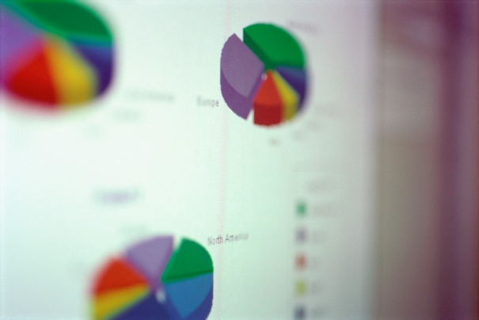
Process Improvement
At what level is your organization primarily functioning?
  Do a quick assessment on your own based on the work you did earlier on Portfolio Maturity
  Then compare notes with another class member
    What project and process areas work well in your organizations? What causes them to work well?
    What areas need improvements? What types of improvements?
Dr. Richard Scudder Copyright 2018
60

Slide 61

Program Measures -
Life Cycle
The idea of a lifecycle has been used in certain industries, such as construction, for many years
The PMI project life cycle is split into five phases or process groups:
  Initiating processes
    Getting the project started
  Planning processes
    Defining the project plan, the amount of work (scope), the activities (tasks), scheduling, costs, resources needed, risk assessment, change and communication management
  Executing processes
    Executing the plan, quality assurance, team development, reporting, soliciting and administering contracts
  Controlling processes
    Change control, scope verification, and schedule, cost, quality, and risk control
  Closing processes
    Administrative and contract close-out
Dr. Richard Scudder Copyright 2018
61

Slide 62
Program Measures –
Process Improvement
The project life cycle is split into five phases in this course
You may use another approach in your organization
The number of phases is not important, results are!
Dr. Richard Scudder Copyright 2018
62

Slide 63
Process Improvement –
Knowledge Areas
The PMI BOK is organized into nine knowledge areas:
  Integration
  Scope
  Time
  Cost
  Quality
  Human Resources
  Communication
  Risk
  Procurement
Specific instances and applications of these nine areas were shown several slides back under the project phases
By measuring the use of these knowledge areas across your project life cycle, you can determine your organization’s maturity … and its likelihood of having successful projects!
Dr. Richard Scudder Copyright 2018
63

Slide 64
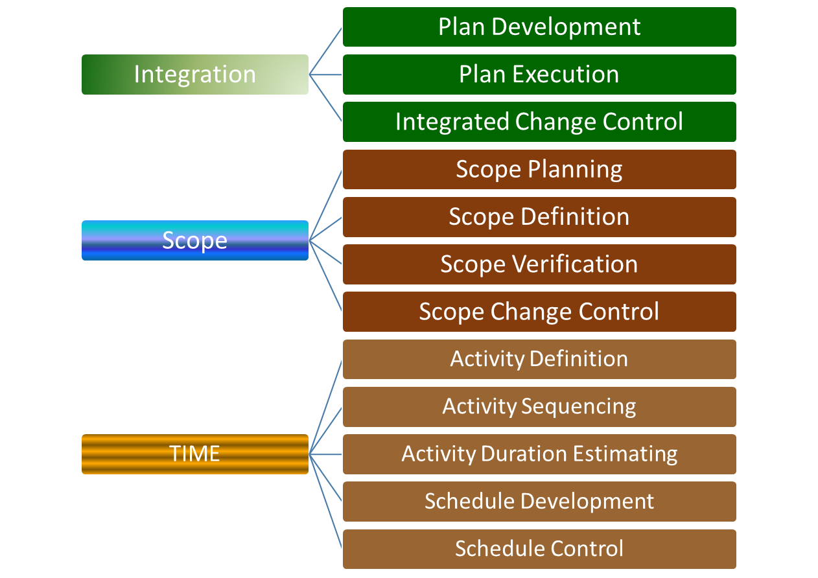
PMI Knowledge Areas and Process Areas
Dr. Richard Scudder Copyright 2018
64

Slide 65
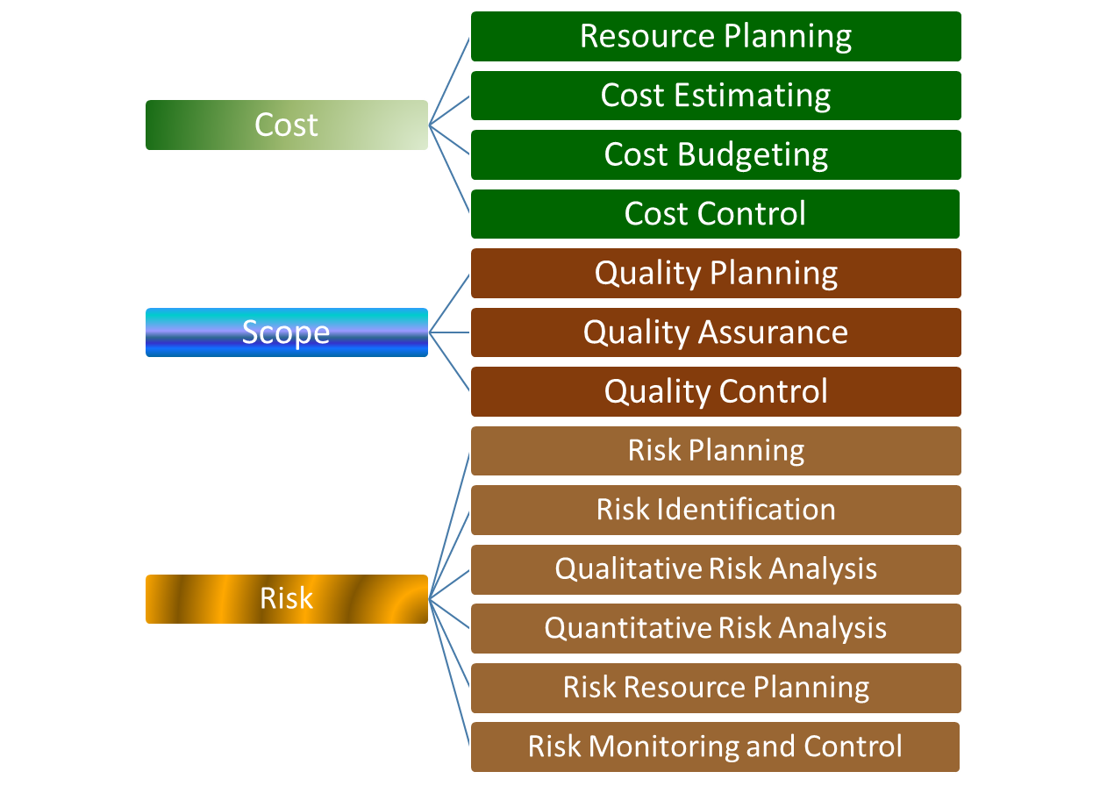
PMI Knowledge Areas and Process Areas
Dr. Richard Scudder Copyright 2018
65

Slide 66
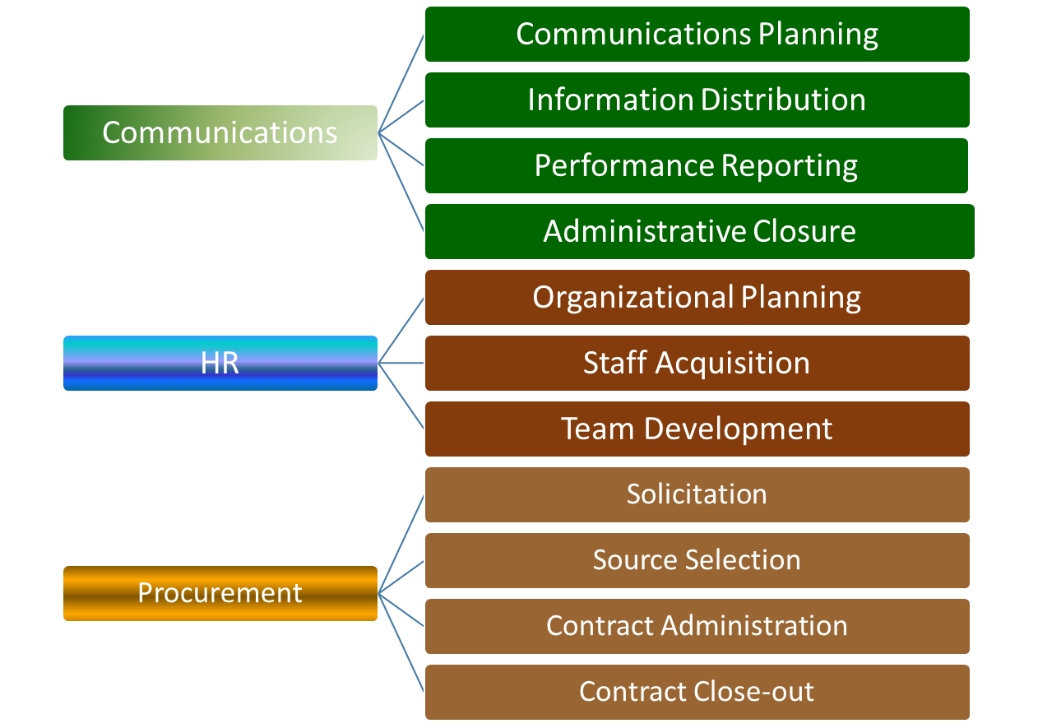
PMI Knowledge Areas and Process Areas
Dr. Richard Scudder Copyright 2018
66

Slide 67

A Story of
Process Improvement
Once there was a manufacturing company, ComPete Manufacturing, which was successful despite being in a very competitive market.
They had fairly good project management in place and were reasonably profitable.
Then a small black swan appeared - one of their competitors found a way to reduce their transportation costs by almost 8% by using the experimental Kenwins ™ hybrid hydrogen-electric tractor to haul their trailers and products to customers. Cutthroat formed an alliance with Kenwins for a 3 year test of the new hybrid system.
Dr. Richard Scudder Copyright 2018
67

Slide 68

ComPete –A Process Improvement Story
What would you do?
  Management is in a bit of a panic.
  None of your colleagues in the transportation department can figure out how to deal with the situation.
  ComPete’s banks and investors saw the news in a press release and are applying pressure and want immediate action.
Dr. Richard Scudder Copyright 2018
68

Slide 69
ComPete –A Process Improvement Story
  Where would you start?
    Hint: set up a project
    What kind of a project? And why?
  What would you do?
    Hint: assemble a small team of supporters
    Who and why?
  What are your next steps?
Dr. Richard Scudder Copyright 2018
69

Slide 70
ComPete Options
Supply chain efficiencies
Internal systems efficiencies
Smoothing delivery systems
Process efficiencies
  Engineering
  Manufacturing
  Marketing/Sales
  Project management
Dr. Richard Scudder Copyright 2018
70

Slide 71
ComPete –
Program Measures
V.K. and the former task force team members, who now constituted most of the Reducing Project Failures project team, immediately set out to identify the reasons why ComPete projects were failing:
  V.K. collected a list of the most recent project failures, and constructed a fishbone diagram to isolate the reasons for the failures. (See next slide for the fishbone diagram)
  Meanwhile, members of V.K.’s project team interviewed the project managers and team members from the project teams to identify the reasons they thought those projects failed.
  V.K. and the RPF project team used the phases of their project plan to identify where the problems came from.
Dr. Richard Scudder Copyright 2018
71

Slide 72
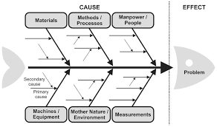
Fishbone Analysis
Cause and Effect
Use when identifying possible causes for a problem
Useful for getting out of ruts in thinking
Process:
  Agree on a problem statement. Write it on the right center.
  Brainstorm the major categories of causes of the problem – use this diagram as a starter
  Write the categories of causes as branches from the main arrow
  Brainstorm possible causes of the problem – how does this happen? Link cause as a branch from the appropriate category.
  Ask why does this happen? Write sub-causes as branches
Dr. Richard Scudder Copyright 2018
72
Notes:
72

Slide 73
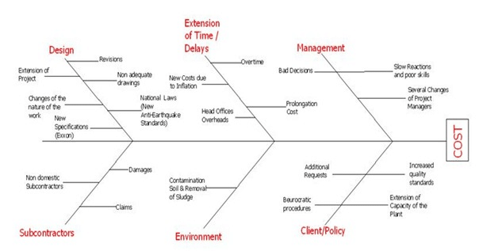
Sample
Dr. Richard Scudder Copyright 2018
73

Slide 74
Case Study
Read the ComPete case study
Define the problem
Define causes
Construct a fishbone diagram
Dr. Richard Scudder Copyright 2018
74

Slide 75
ComPete –
Program Measures
  Fishbone diagram of project failure areas structured around ComPete’s project phases
Initiation
Planning
  Resources are not always
  available when needed
Internal customers don’t want to participate
Requirements are not clearly identified
Process too hard
to understand
Project failure
rate is 45%
Lack of clear
problem definition
Documentation is poor
Change management is weak
Acceptance is often long and drawn out
  Resources are not always
  available when needed
Existing project process is
not followed very closely
  Acceptance is difficult because
  project requirements aren’t clear
Construction
Closeout
Design
Dr. Richard Scudder Copyright 2018
75
Notes:
75

Slide 76
ComPete –A Process Improvement Story
There are a number of problem areas which should be identified by the fishbone diagram:
  Scope management is difficult
    Requirements are not clearly identified
    Internal customers don’t want to participate in parts of the project process
    Documentation is poor
    Change management is weak
    Acceptance criteria are vague
  Resource management is weak
    Resources are not available when needed, including at project startup
    Some projects go over their estimated time frame
  Schedule and costs are not well managed
    Poor planning results from poorly understood requirements and missing team members
    Reports and documentation are not useful
Dr. Richard Scudder Copyright 2018
76

Slide 77
ComPete – Scope, Time, Cost, and HR Box Charts
V.K. and the PFR team looked for any discrepancies between process practice and process definition in the scope, time, cost, and HR areas
The next slide shows that there are indeed splits between definitions and practices
It also shows that most of the process are significantly below a level 3 of maturity
Dr. Richard Scudder Copyright 2018
77

Slide 78
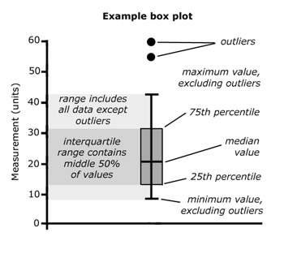
Tools: Box and Whisker Plot
Dr. Richard Scudder Copyright 2018
78

Slide 79
ComPete – Scope, Time, Cost, and HR Box Charts
PD Baseline
5
4
3
2
1
Process definition
Time
Cost
HR
Scope
Dr. Richard Scudder Copyright 2018
79

Slide 80
ComPete –A Process Improvement Story
Next V.K. and the project team referred to the Project Management Maturity Model (PMMM) to explore where the scope management issues might be coming from.
According to the PMMM, there are five processes involved in scope management, which is one of the nine PMI knowledge areas:
  Initiation
  Scope planning
  Scope definition
  Scope verification
  Scope change control
Dr. Richard Scudder Copyright 2018
80

Slide 81
ComPete –A Process Improvement Story
In their analysis of the five process areas of scope management, the RPF team noted that the surveys showed considerable differences in how well the various project teams were following the process in each of the five areas.
The RPF team concluded that it was possible that the project team members they surveyed had different understandings of the processes; or it might be that they simply did not follow those processes.
If there were different understandings of the process, V.K. and the RPF team needed to make sure that the documentation was clear, correct, and complete. Then they could insist that team members for future project teams follow that process.
It was also possible that ComPete’s project teams never accepted the new process, possibly because the documentation wasn’t clear or possibly for other reasons. If that turned out to be the case, the project team members would need to see the value of following the process.
  Just telling them to follow it probably wouldn’t change their behavior.
  They would need training in what to do, why to do that, and follow-up to show them that their change in approach was actually worthwhile.
Dr. Richard Scudder Copyright 2018
81

Slide 82
Case Study
Review Case Study 5 as a team.
Prepare a set of box and whisker diagrams to show what level Compete is currently at in scope management
Present your ideas to the class.
Dr. Richard Scudder Copyright 2018
82

Slide 83
ComPete – Scope Management Box Chart
PD Baseline
5
4
3
2
1
Initiation
Scope Definition
Scope Verification
Scope Change Control
Scope Planning
Dr. Richard Scudder Copyright 2018
83

Slide 84
ComPete –
Force Field Chart
V.K. looked more closely at the scope change control process. He saw that only a few teams were following the documented process, so he concluded that something might be wrong with the process itself.
After examining it, he concluded that the process was incomplete and that it did not work well for the project teams.
The team decided to use a force field analysis to examine the issues.
Dr. Richard Scudder Copyright 2018
84

Slide 85
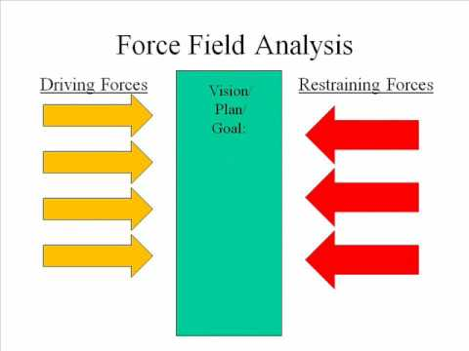
Force Field Analysis
When examining difficult issues it is useful to have an effective structured technique to help improve the quality of your analysis, like the Force Field Analysis method.
Dr. Richard Scudder Copyright 2018
85

Slide 86
Using Force Field Analysis
Define the major issue you want to change
Identify the drivers for change
  New Products
  New Competition
  New Methods
Try to identify as many issues as you can
Identify drivers preventing the change
  Outdated processes
  Team morale
  Fears of Change
Drivers for change go on the left or bottom, driver against change on the opposite side.
Dr. Richard Scudder Copyright 2018
86

Slide 87



ComPete –
Force Field Chart
Lack of Templates
Does not meet needs
No access to training
Overburdened by process
Scope change control PP maturity values are below PD values
Process Documented
Project reviews
Scheduled training
Consulting available
Dr. Richard Scudder Copyright 2018
87

Slide 88

Case Study 5
Dr. Richard Scudder Copyright 2018
88

Slide 89
Case Study 5
Dr. Richard Scudder Copyright 2018
89

Slide 90
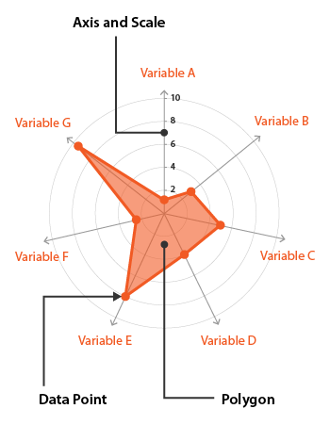
ComPete –A Process Improvement Story
This also lead V.K. and the RPF team to look at project team skills to determine where there might be deficiencies in basic project skills
The results of that analysis are shown in the Kiviatt or Radar chart on the next slide
Dr. Richard Scudder Copyright 2018
90

Slide 91
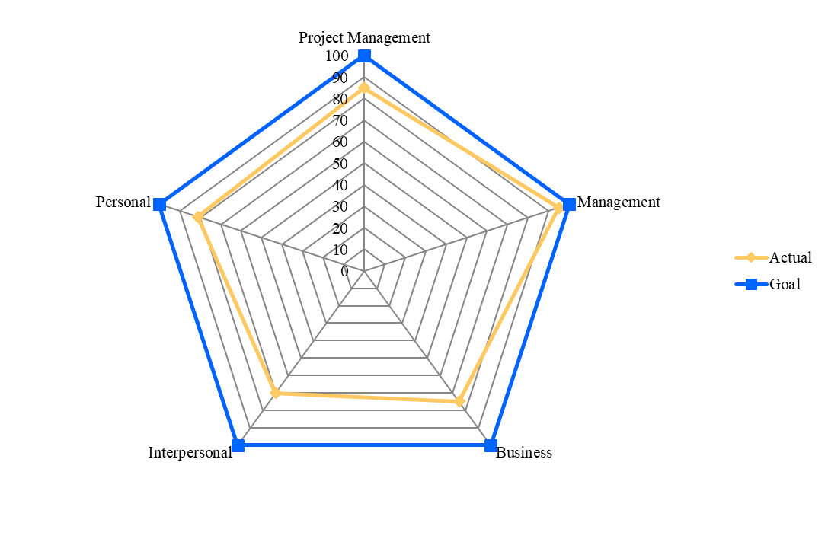
ComPete –Skill Profile
Dr. Richard Scudder Copyright 2018
91

Slide 92
ComPete –A Process Improvement Story
There were other techniques available to the RP team to find out why ComPete projects had a high failure rate
Some of them are listed below:
  Force field analysis
  Root cause analysis
  Pareto charts
  Cause-effect graphs
Dr. Richard Scudder Copyright 2018
92

Slide 93

ComPete –A Process Improvement Story
Process Improvement considerations:
1) There are a variety of techniques which can be used to improve project and program processes.
2) Many organizations have not done the level of analysis and process improvement discussed in this section.
3) Improvement efforts are almost always exploratory early in the process. There is a lot of guesswork and learning of new tools.
4) Process changes affect the culture of your organization.
5) Therefore, make limited amounts of changes, giving time to the project teams to learn the new approaches.
Dr. Richard Scudder Copyright 2018
93

Slide 94

Balanced Scorecard (BSC)
The scorecard mentioned in the Metrics section can be taken to a higher level of usability, the Balanced Scorecard
The Balanced Scorecard started as an improved measurement system
It was developed by Drs. Robert Kaplan and David Norton, and first presented by them in a 1992 Harvard Business Review article
Dr. Richard Scudder Copyright 2018
94

Slide 95
Balanced Scorecard
Next, the BSC evolved into an improved management system
People have used the BSC as a framework to organize
  Goal setting
  Planning
  Budgeting
  Resource allocation
  Etc
Dr. Richard Scudder Copyright 2018
95

Slide 96
Balanced Scorecard
Now the BSC has evolved into a total strategy management system
The BSC is part of a process to align objectives, measures, targets, and initiatives with organizational strategies
Said another way, the organizational mission is mapped to a strategy map which is then detailed as a balanced scorecard. The BSC is implemented to achieve whatever goals the organization has decided upon
Dr. Richard Scudder Copyright 2018
96

Slide 97
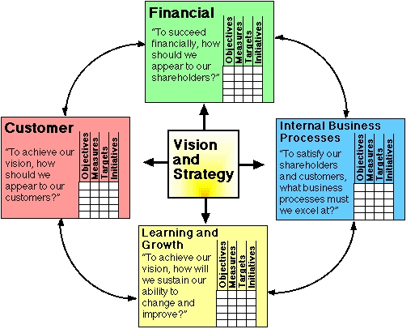
Fundamental
Balanced Scorecard
Dr. Richard Scudder Copyright 2018
97

Slide 98
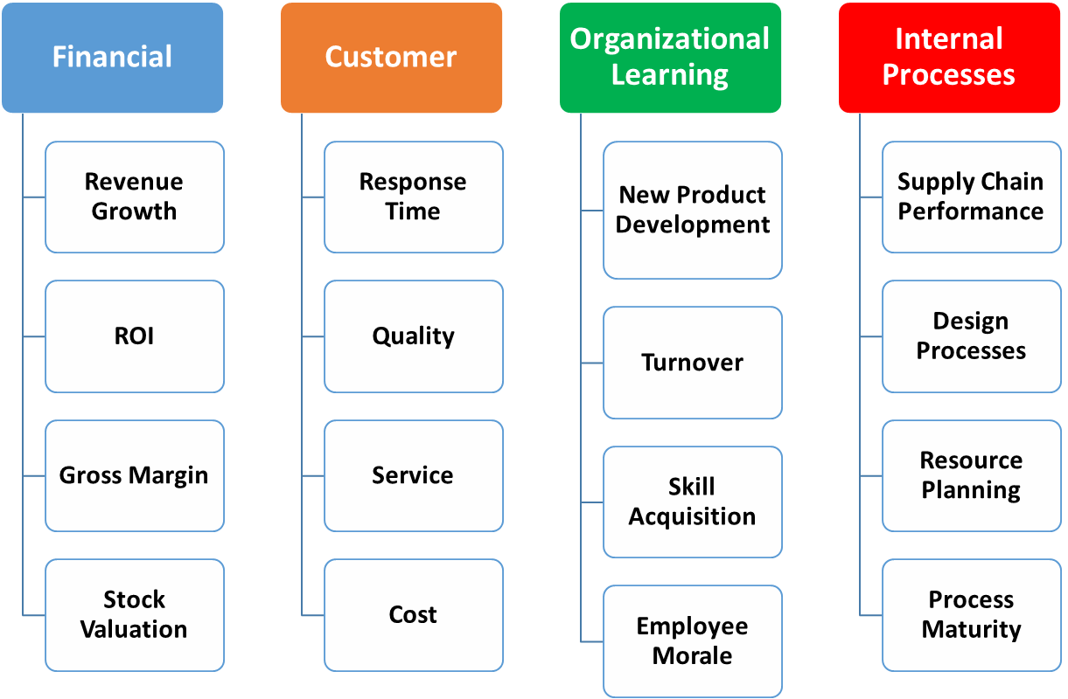
Traditional BSC and Metrics
Dr. Richard Scudder Copyright 2018
98

Slide 99
Balanced Scorecard –
Examples
F | C
O | I
The development and management of this strategy requires significant time and energy commitment from multiple levels of the organization
The payoff can be a high performing organization
  Cigna Property & Casualty was losing $1,000,000/day in 1992. Using the BSC approach to reposition themselves as specialists, they turned the company around
  Within two years, Cigna was profitable
  Within five years, Cigna sold off the Property & Casualty division for $3,000,000,000
Dr. Richard Scudder Copyright 2018
99

Slide 100
Balanced Scorecard –
Examples
F | C
O | I
Mobil Oil’s Marketing & Refining division was last in industry profitability in 1993
Mobil set a new strategy in motion, broke up the division into 18 business units, and presented the new strategy using a BSC
Each business unit built its own BSC cascaded from, and therefore aligned with, the corporate BSC
Within two years, Mobil moved from last to first in the industry, and maintained that position for five years
  Examples from the Balanced Scorecard Collaborative, “Executing Strategy with the Balanced Scorecard: An Introduction to the Strategy-Focused Organization” white paper © 2002
Dr. Richard Scudder Copyright 2018
100

Slide 101
Balanced Scorecard
F | C
O | I
In each of the cases mentioned, the organizations did not have much time to effect the changes. How did they accomplish such significant improvement?
Kaplan and Norton studied the organizations which adopted the BSC early on, interviewing various executives
All the executives mentioned three concepts:
  Strategy –was the main agenda of the organization
  Focus – the strategy was focused upon intently
  Organization – employees acted in fundamentally different ways based upon the strategy
Existing management and measurement systems based upon budgets and operations were replaced by management systems based upon strategy
Dr. Richard Scudder Copyright 2018
101

Slide 102
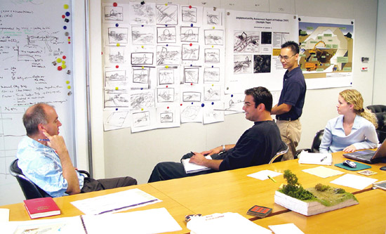
Balanced Scorecard
There are four critical activities in setting up a BSC:
  Articulate organizational strategy – management
  Design measures to indicate how well the strategy is working – core team including BSC “architect”
  Put the strategy into operation, and apply the measures – team, architect, and members of the organization
  Get buy-in for the strategy and the measures. This probably should be the second step in this process!
Dr. Richard Scudder Copyright 2018
102

Slide 103

BSC
Kaplan and Norton found five BSC success principles:
  Mobilize change through executive leadership
  Translate the strategy into operational terms
  Align the organization to the strategy
  Make strategy everyone’s job
  Make strategy a continuing process
Dr. Richard Scudder Copyright 2018
103

Slide 104
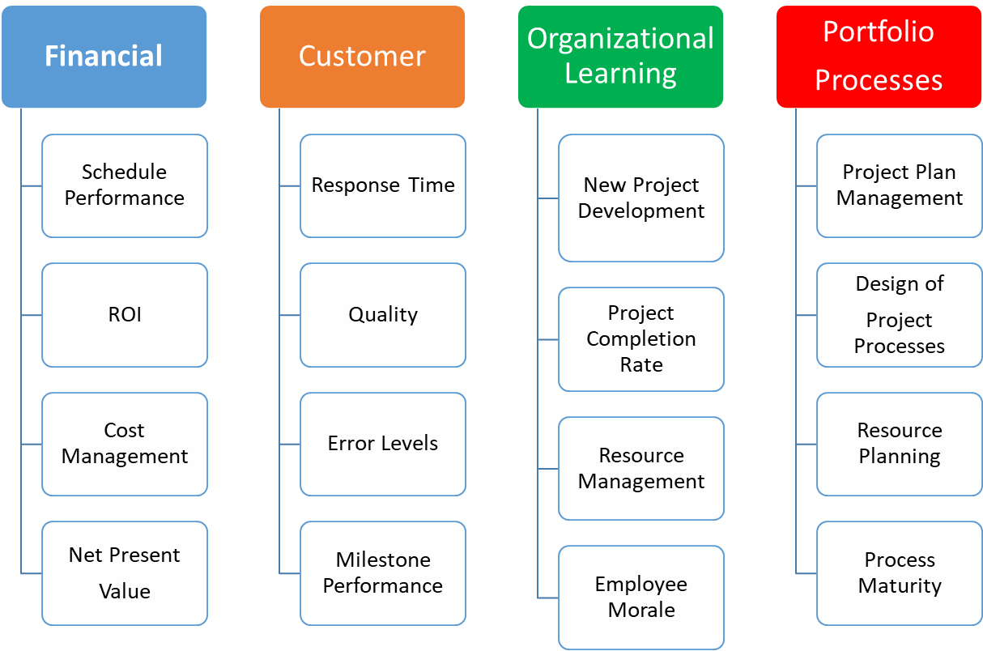
BSC and Program Metrics
Dr. Richard Scudder Copyright 2018
104

Slide 105
Case Study
Dr. Richard Scudder Copyright 2018
105

